Slide 1
Z Transform

Slide 2
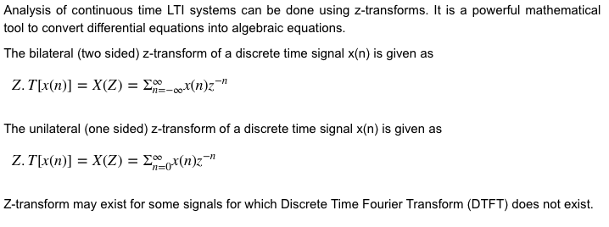

Slide 3
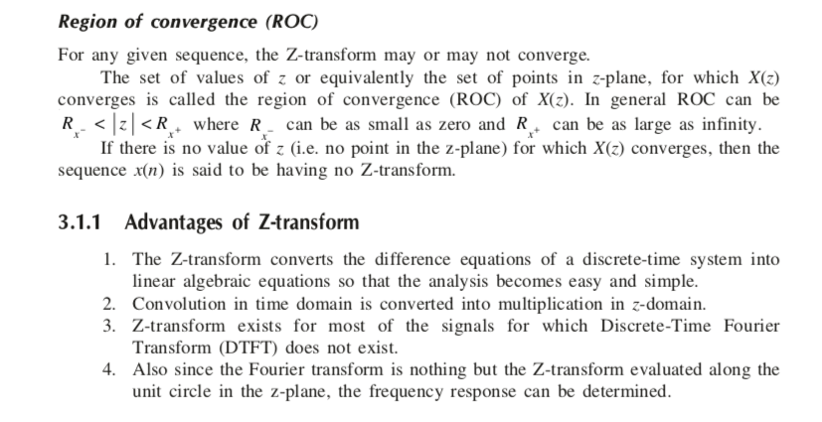

Slide 4
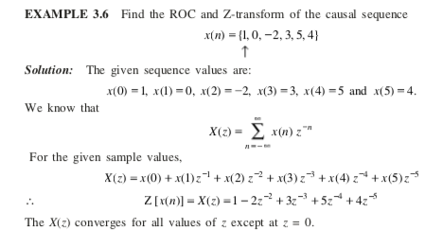

Slide 5
ROC is defined as range of values of z for which X(z) is
Converges
Diverges
Is zero
Is infinite

Slide 6
a

Slide 7
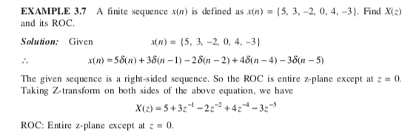

Slide 8
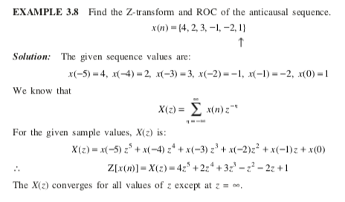

Slide 9
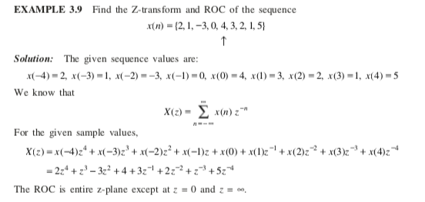

Slide 10
The only signal whose ROC is entire z plane is
A. δ(n)
B. u(n)
C. r(n)
D. none of the above

Slide 11
a

Slide 12
The ROC of sum of two or more sequences is equal to
A. intersection of those ROC’s
B. union of those ROC’s
C. sum of those ROC’s
D. product of those ROC’s

Slide 13
a

Slide 14
The ROC of X(z) cannot contain any
A. Poles of X(z)
B. zeros of X(z)
C. Poles or zeros of X(z)
D. Multiple Poles of X(z)

Slide 15
a

Slide 16
The ROC of a causal stable system must include the
A. Origin
B. Infinity
C. A ring
D. Unit circle

Slide 17
d

Slide 18
Z(u(-n)] is
A. –z/z-1
B. 1/z-1
C. 1/1-z
D. z/z-1

Slide 19
c

Slide 20
The z transform of a signal x(n)= u(n)
A. 1/ (1-z⁻¹)
B. 1/(1- z)
C. 1/ (1+ z⁻¹)
D. z/ (z+1)

Slide 21
a

